Slide 1
Software project Management
FINAL PPT
SLOT: F1+TFF1
Group No: G10

Slide 2
TEAM MEMBERS
21MIC7114 – S. Jayadritha
21MIC7043 – Y. Pavan
21MIS7038 – P. Revanth
21MIS7023 – G. Bhuvan
21MIS7068 – T. Anjali Sri
Under the Guidance of
Prof. Anurag De – SCOPE

Slide 3
FOOD COURT BASED WEB APPLICATION

Slide 4
Introduction
The Online food ordering system sets up a food menu online and customers can easily place the order as per they like. Also with food menu, online customers can easily track the orders.
The management maintains customers database, and improve food ordering service. The restaurant management systems motivates us to develop the system.
There are various facilities provided so that the users of the system will get service effectively . Also, the system considers restaurants as well as mess faculty to the customers.
Another motivation can be considered as the system will be designed to avoid users doing fatal errors, users can change their own can provided feedback and recommendations and can give ratings, it will give appropriate feed backs to restaurants/ mess service providers

Slide 5
Background study
The main purpose of the online food ordering management system is to use it in the food service industry.
The feature helps hotels and restaurants to increase their online food ordering system. Customers can choose from a wide range of food menu items within just a few minutes .
In todays modern food business, its also able to deliver fast and easily to a customers place. The work presented as online food ordering management system simplifies the ordering process.
The proposed solution presents a user interface and changes the menu to include all available options, creating customer work easier.

Slide 6
Allows customer to order any item that they like and adjust the quantity of the food item.
The order confirmation is displayed to the customer on the Home page of the website
The order is put to the queue, updated across both the database and admin panel, and provided in real-time.
This system aids the staff with checking over orders in real-time and executing them effectively and easily.

Slide 7
Literature survey
In an automated food ordering system is proposed which will keep track of user orders smartly. Basically, they implemented a food ordering system for diﬀerent type of restaurants in which user will make order or make custom food by one click only.
In Customer using a Smartphone is considered as a basic assumption for the system. When the customer approach to the restaurant, the saved order can be conﬁrmed by touching the Smartphone.
In research work aims to design and develop a wireless food ordering system in the restaurant. Technical operations of Wireless Ordering System (WOS) including systems architecture, function, limitations and recommendations were presented in this system.

Slide 8
S.no | Title of the paper | Year of Publication | Benefits | Flaws
1. | An Online Food Court Ordering System | 2016 | Customers can browse menus, place orders, and make payments from the comfort of their homes or workplaces, saving time and effort. | System crashes, slow loading times, or glitches can frustrate customers and disrupt business operations.
2. | Review on Food Court goes Smart with Cloud: Opportunities and Threats | 2018 | Online ordering systems can attract more customers who prefer the convenience of ordering digitally, leading to higher sales volumes. | Online transactions involve sensitive customer information, making them susceptible to hacking or data breaches if the system's security measures are inadequate.
3. | Principles and Systems for Quality and Food Safety Management | 2023 | Automated systems minimize errors in taking orders, leading to increased customer satisfaction and fewer complaints. | Some customers may prefer the human interaction and personalized service offered by traditional food court experiences.
4. | Manure management and soil biodiversity: Towards more sustainable food systems in the EU | 2021 | Resolving customer complaints or issues with orders may be more challenging in an online setting compared to face-to-face interactions. | Developing and implementing a robust online ordering system can require significant upfront costs, including software development, hardware, and training.
5. | Food for Thought: Investing in a sustainable food system | 2021 | These systems can collect valuable data on customer preferences, ordering habits, and sales trends, which can be used for marketing strategies and business improvement. | With the proliferation of online food ordering platforms, businesses may face increased competition, making it harder to stand out and attract customers.

Slide 9
It was believed that with the increasing use of handheld device such as PDAs in restaurants, pervasive application will become an important tool for restaurants to improve the management aspect by minimizing human errors and by providing higher quality customer service.
In the purpose of this study was to investigate the factors that influence the attitude of internet users towards online food ordering in Turkey among university students. A Technology Acceptance Model (TAM) developed by Davis in 1986 was used to study adoption of Web environment for food ordering.
In the research work aims to automate the food ordering process in restaurant and also improve the dining experience of customers. Design implementation of food ordering system for restaurants were discuss in this paper. This system, implements wireless data access to servers. The android application on user’s mobile will have all the menu details. Kitchen and cashier receives the order details from the customer mobile wirelessly.

Slide 10
Objectives
The reason why to choose this project is the idea behind project that is to solve problem of people which they shift to different city. The system is not only for the users but also for provider who provides food service .
This system is for making efficient communication between customer and producer of the food system which will then leads to the ideal and effective system.
This system also provides a feedback system in which users can rate the food items. Also the proposed system can recommend hotels , food, based on the ratings given by the user, the hostel staff will be infirmed for the improvements along with the quality.

Slide 11
Proposed Methodology
To overcome the limitations of above system, an online food ordering system based on internet of things is proposed. It is a wireless food ordering system using android devices.
Android devices have gained immense popularity and have revolutionized the use of mobile technology in the automation of routine task in wireless environment.
Android is a Linux based operating system for mobile devices such as smart-phone and tablet.
To develop a reliable, convenient and accurate food ordering system is considered as a general objective of the study.

Slide 12
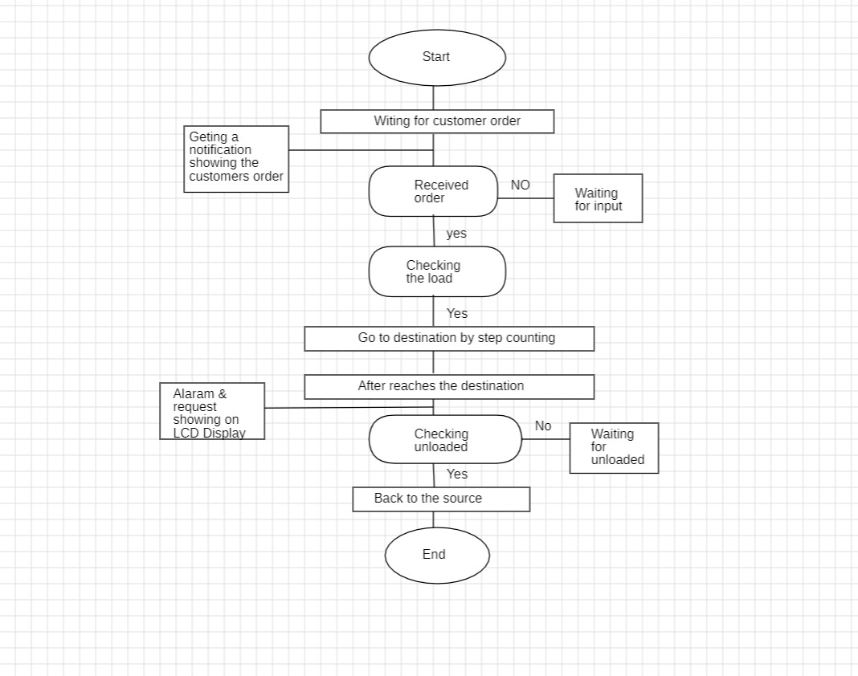

Slide 13
To develop a system that will surely satisﬁed the customer service will be considered as an objective. One of the Objective is to design a system that is able to accommodate huge amount of orders at a time and automatically compute the bill.
To evaluate its performance and acceptability in terms of security, user-friendliness, accuracy and reliability is an important objective. To improve the communication between the client and customers is one of the objective.
The architectural design consists of 3 main users: - Service Consumer, Owner of Mess/Restaurant, and Employee of mess.
Here the main function is, in what pattern user will search the service so for that purpose a part of Geo-Hashing Algorithm is used, and GPS system should be on. Person can have the facility to search service by location that is home location of the person is detected with GPS and according to selected option location of nearby service get searched. Another way for searching is by cost. Here user must give input in terms of rupees that in what range he/she need service per plate if there are any service provider within that area than the list will display.

Slide 14
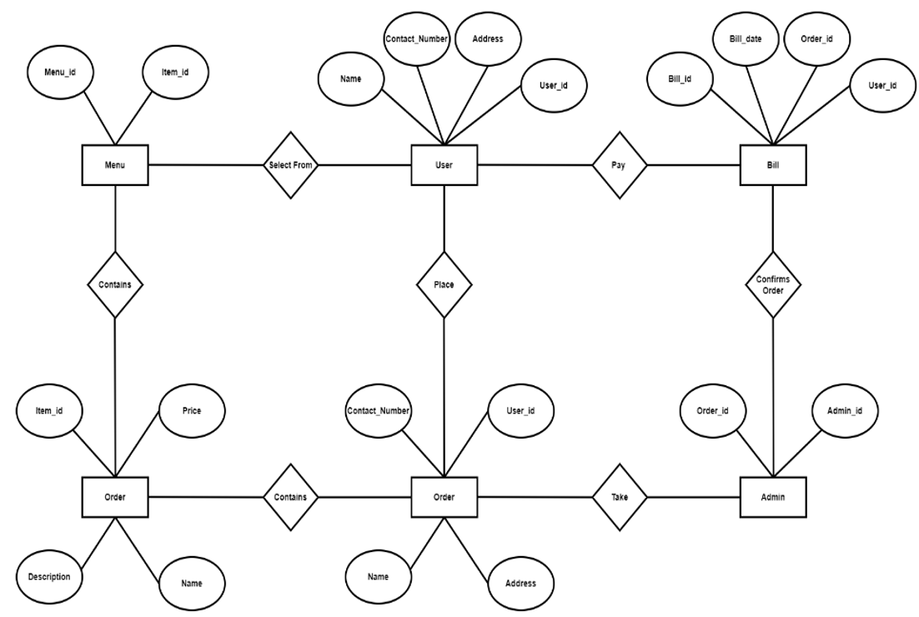
ER Diagram

Slide 15
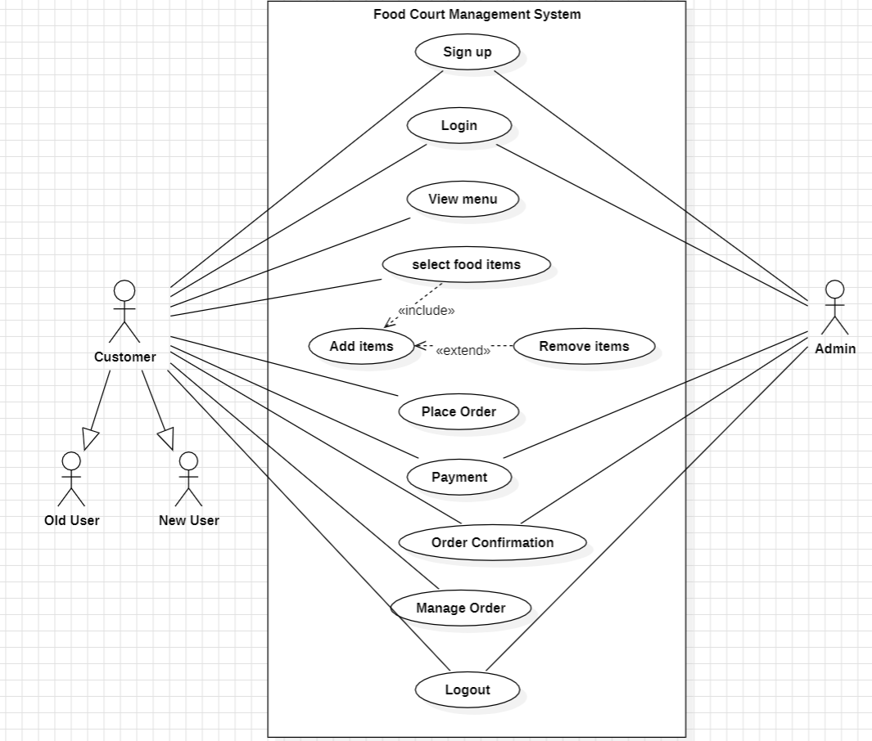
UML Diagrams
Use case Diagram

Slide 16
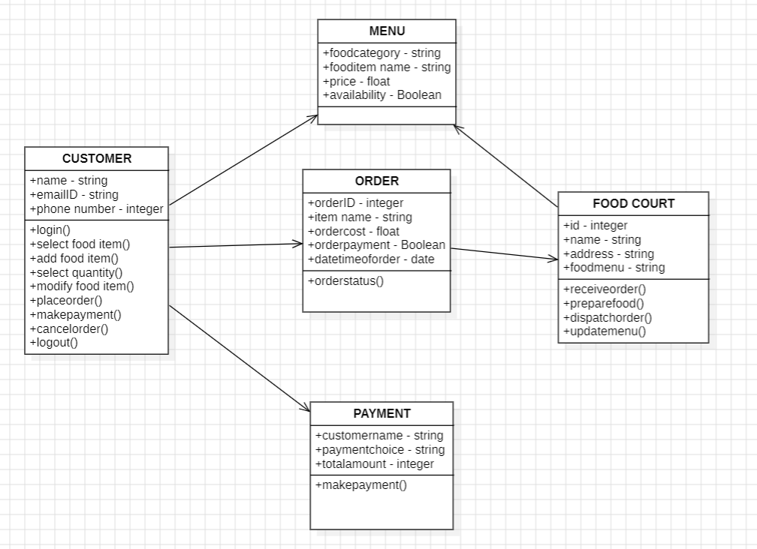
Class Diagram

Slide 17
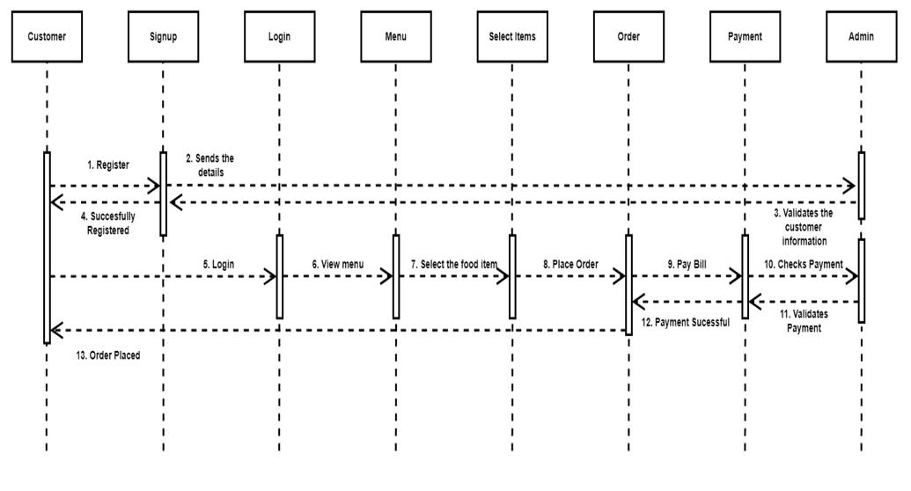
SEQUENTIAL Diagram

Slide 18
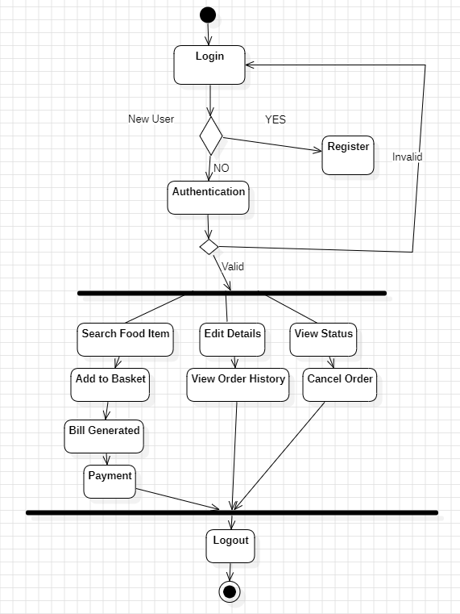
Activity diagram

Slide 19
References
[1] Kirti Bhandge, Tejas Shinde, Dheeraj Ingale, Neeraj Solanki, Reshma Totare,”A Proposed System for Touchpad Based Food Ordering System Using Android Application”, International Journal of Advanced Research in Computer Science Technology (IJARCST 2015).
[2] Varsha Chavan, Priya Jadhav,Snehal Korade,Priyanka Teli, ”Implementing Customizable Online Food Ordering System Using Web Based Application”, International Journal of Innovative Science, Engineering Technology(IJISET) 2015.
[3] Resham Shinde, Priyanka Thakare, Neha Dhomne, Sushmita Sarkar, ”Design and Implementation of Digital dining in Restaurants using Android”, International Journal of Advance Research in Computer Science and Management Studies 2014.
[4] Ashutosh Bhargave, Niranjan Jadhav, Apurva Joshi, Prachi Oke, S. R Lahane,“Digital Ordering System for Restaurant Using Android”, International Journal of Scientific and Research Publications 2013.
[5] Khairunnisa K., Ayob J., Mohd. Helmy A. Wahab, M. Erdi Ayob, M. Izwan Ayob, M. Afif Ayob, ”The Application of Wireless Food Ordering System” MASAUM Journal of Computing 2009.

Slide 20
[6] Noor Azah Samsudin, Shamsul Kamal Ahmad Khalid, Mohd Fikry Akmal Mohd Kohar, Zulkifli Senin, Mohd Nor Ihkasan,” A customizable wireless food ordering system with real time customer feedback”, IEEE Symposium on Wireless Technology and Applications(ISWTA) 2011.
[7] Serhat Murat Alagoza, Haluk Hekimoglub,” A study on tam: analysis of customer attitudes in online food ordering system”, Elsevier Ltd. 2012.
[8] Patel Krishna, Patel Palak, Raj Nirali, Patel Lalit,” Automated Food Ordering System”, International Journal of Engineering Research and Development (IJERD) 2015.
[9] Mayur D. Jakhete, Piyush C. Mankar,” Implementation of Smart Restaurant with e-menu Card,” International Journal of Computer Applications 2015 of Smart Restaurant with e-menu Card,” International Journal of Computer Applications.
[10] Abhishek Singh, Adithya R, Vaishnav Kanade, Prof. Salma Pathan“ ONLINE FOOD ORDERING SYSTEM” International Research Journal of Engineering and Technology (IRJET) 2018.

Slide 21
Thank you

